Slide 1
MC Williams Middle School
“The Way We Do It”
2023-2024

Slide 2
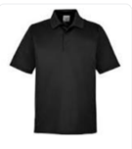
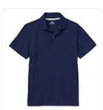
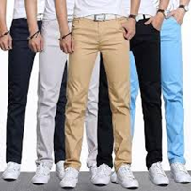
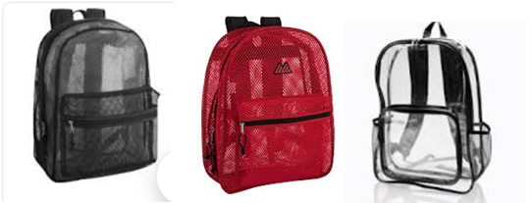
Dress Code
Appropriate solid shirt (6: gray, 7: navy, 8: black) with no writing or graphics.
Pants or capri pants to the knee (denim, black, khaki) NO RIPS, TEARS, or EXPOSED SKIN
No Crocs or open back shoes (for safety purposes)
Clear or mesh backpacks only
Hoods are not worn in halls or classrooms
Teachers are checking for dress code violations each period

Slide 3
Dress Code: Offenses vs. Consequences
1st Offense: Change clothes/shoes (if applicable), confiscate inappropriate clothes, call home, return to student EOD
2nd Offense: Change clothes/shoes (if applicable), confiscate inappropriate clothes, call home, return to parent, Uniform Contract
3rd Offense: Change clothes/shoes (if applicable), confiscate inappropriate clothes, call home, return to parent pickup, Uniform Contract, lunch detention.

Slide 4
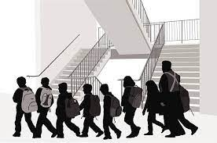
Hallway Transitions
Every staff member assists with supervision during transitions
Students walk through halls at a Voice Level 0/ Single-file Line to the right/ Hoods Off
Teachers receive students at threshold and greet students (warm/welcoming)
Dismissal Expectations:
Admin dismissal-Students will not move until released by admin or announcement
Teachers walk students out of the building, out of the gate, onto the Knox St.
We encourage students to depart safely and quickly

